Slide 1
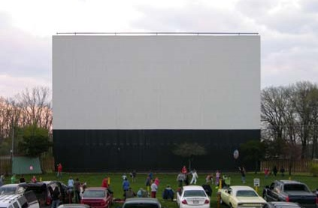

Rhinebeck Masterpiece Drive-In Theater

Slide 2
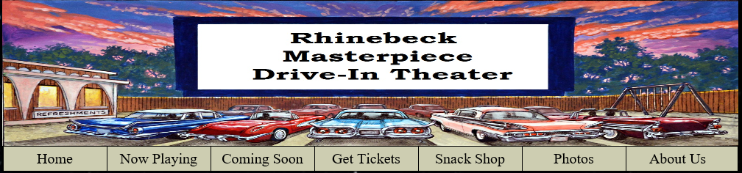
Above is the header which follows all of the pages encompassing the website. It provides a menu bar which provides links to 6 additional pages beyond the main index page.

Slide 3
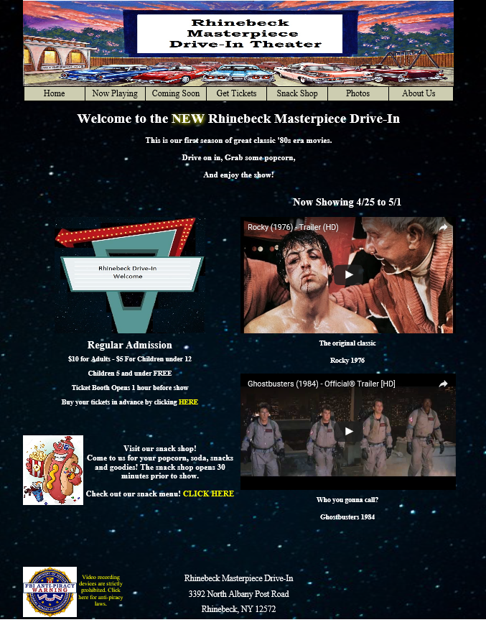
This is the main index page of the website.
It contains a header with a menu bar.
It showcases two previews of movies “now playing” using embedded YouTube.
It provides a link on the index page to purchase tickets on line.
Below is a link to view the menu of the snackbar. This menu is setup using XML and formatted using XSLT.

Slide 4
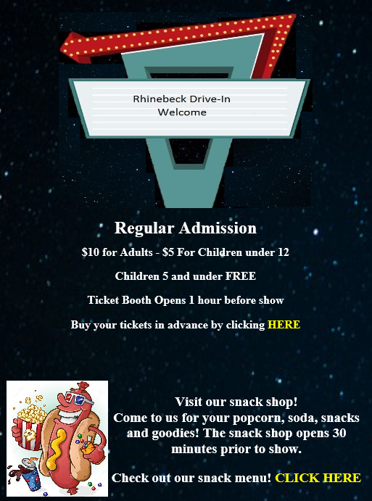
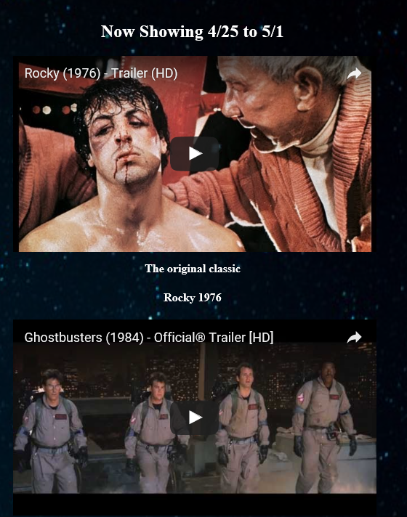
The left shows close ups of the embedded you tube showing the two previews of films now playing. Also shown is a close up of the marquee above our admission prices, a link to purchase tickets and the link for the snack bar menu.

Slide 5
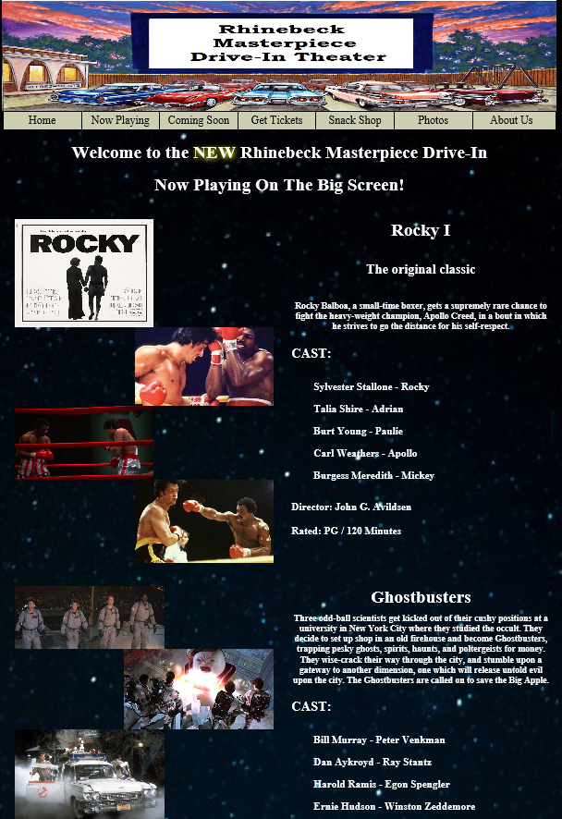
The “Now Showing” page featuring Rocky and Ghostbusters.
Each movie has 4 screenshots from the film as well as a short plot summary, actors and the director.

Slide 6
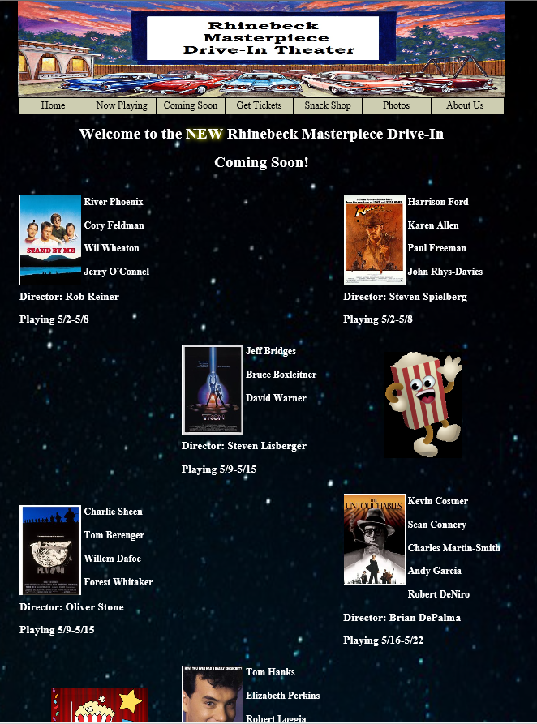
Coming soon to the Rhinebeck Drive-In Theater.
This page provides a list of all upcoming movies coming to the theater over the next month.
Provided for each movie is a image of the film cover as well as actor, and the director.
Finally, provided also is the week the movie will be playing at the theater.

Slide 7
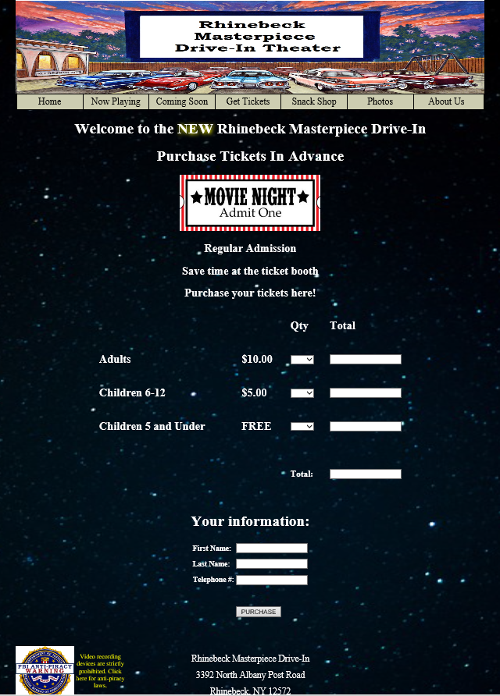
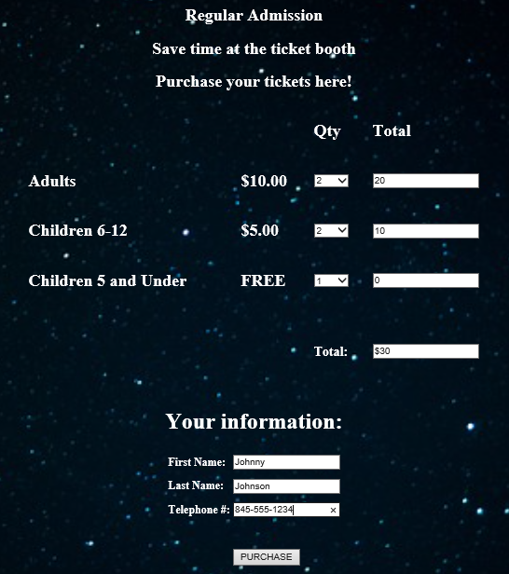
The movie ticket purchase page. Information required is the number of tickets purchased first name, last name and telephone number. The form adds up each column across and gives a total cost at the bottom.

Slide 8
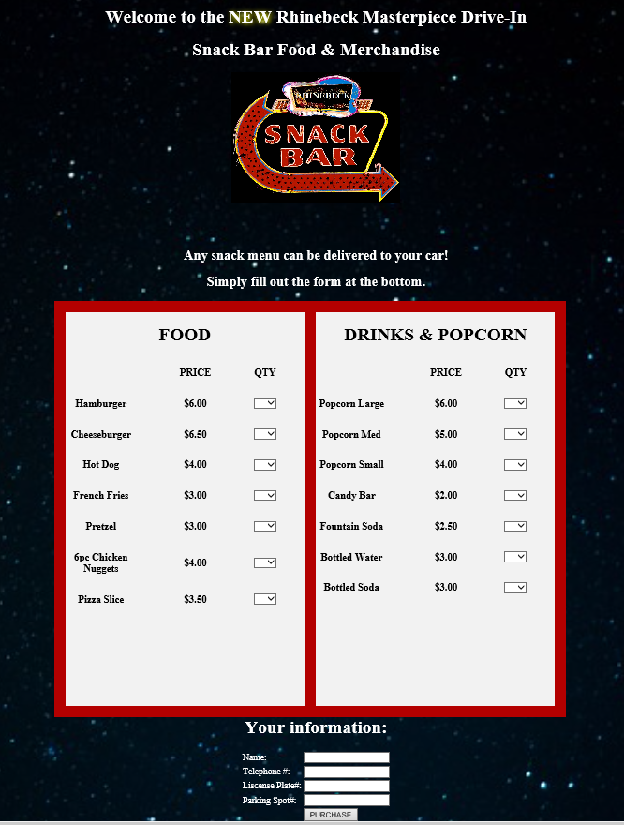
How about having food delivered to your car during the movie?
Fill out this form with your selections and be sure to fill out the bottom so we know where to deliver to. Credit cards are not accepted so payment is cash on delivery.
When the purchase button is pushed, the order finalizes and the purchase information is submitted to the server and the order will be filled.

Slide 9
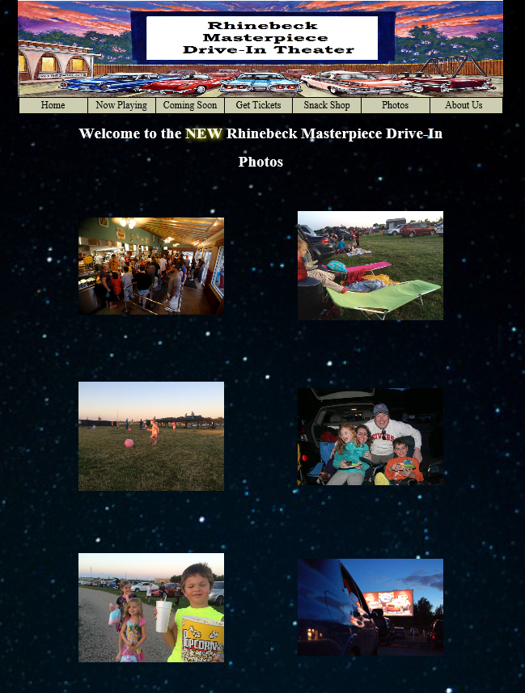
Everyone always has a great time at Rhinebeck Drive-In.
Checkout other families having movie night at the Drive-In.

Slide 10
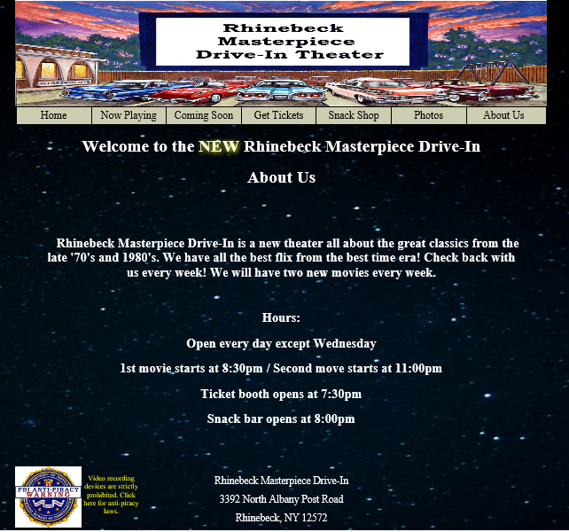
An About US page telling about the theater itself and the films it plays.
Provided also are the theater hours and snack bar hours.

Slide 11
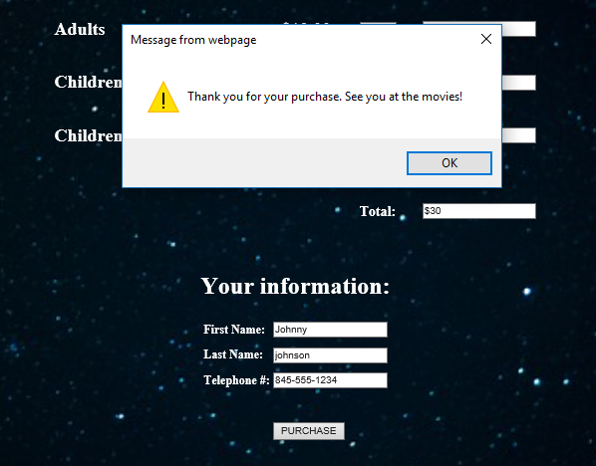
After a purchase of movie tickets online, three things happen behind the scenes.
A cookie is dropped containing the customers first name so if they return to the site, it will greet them on the index page.
Secondly, an script is run that will prompt an alert box that thanks the customer for their purchase.
Finally, the ticket purchase as well as the customers information is submitted to the server to save the purchase information

Slide 12
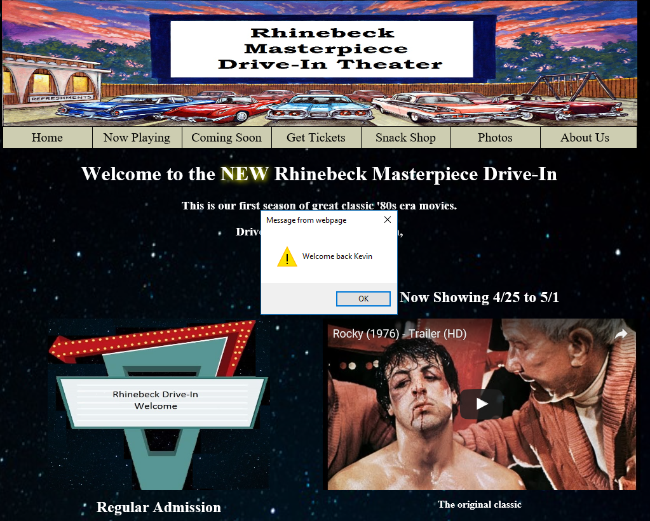
Upon returning to the website, when you land at the index page, if a cookie is present, it will welcome you back to the website.

Slide 13
The following technologies were used in the creation of this website:
HTML
CSS
JavaScript
JavaScript Cookies
XML
XSLT
Embedded YouTube API’s
ASP and SQL for form creation

